Slide 1
Data Structures – Week #9
Sorting

Slide 2
Outline
Motivation
Types of Sorting
Elementary (O(n²)) Sorting Techniques
Other (O(n*log(n))) Sorting Techniques

Slide 3
Sorting

Slide 4
Motivation
Sorting is a fundamental task in many computer science problems.
To sort a set of data is to put the data points (or records) in some order with regard to some feature of data.
In a student registration system, an example to sorting would be to put the student records in ascending order with respect to students’ IDs.

Slide 5
Types of Sorting
Sorting techniques may be classified based on whether the entirety of data fits in the main memory.
Sorting techniques for data that entirely fit in the main memory are called the internal sorting techniques.
Those for data that do not are called the external sorting techniques.
We will discuss internal sorting techniques.

Slide 6
Elementary Sorting (O(n²))Techniques
We discuss three (internal) sorting techniques
  Selection Sort
  Insertion Sort
  Bubble Sort
Others: Comb sort (improvement on bubble), shell sort (improvement on bubble and insertion), radix sort, counting sort, bucket sort

Slide 7
Selection Sort
void selectionSort(unsigned int *a, unsigned int n)
//sorts n integers in ascending order (i.e., a[n]<a[n+1])
{
int i, j, min;
for (i=1; i<n; i++) {
// i^{th} smallest number gets placed in its correct position.
min=i;
for (j=i+1; j<=n; j++)
if (a[j] < a[min]) min=j;
swap(a[min],a[i]);
}
}

Slide 8
Selection Sort Example
48
16
24
20
8
12
32
54
72
i
j
for (i=1; i<n; i++) {
min:=i;
for (j=i+1; j<=n; j++)
if (a[j] < a[min]) min:=j;
t:=a[min]; a[min]=a[i]; a[i]=t;
}
min
a[j] < a[min]

Slide 9
Selection Sort Example
8
16
24
20
48
12
32
54
72
i
j
for (i=1; i<n; i++) {
min:=i;
for (j=i+1; j<=n; j++)
if (a[j] < a[min]) min:=j;
t:=a[min]; a[min]=a[i]; a[i]=t;
}
min
a[j] < a[min]
etc.

Slide 10
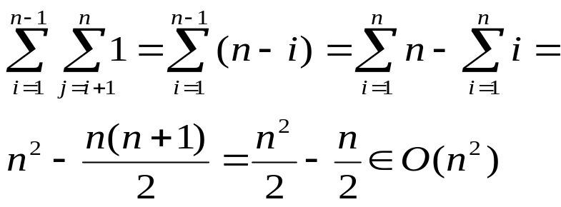
Algorithm Analysis of Selection Sort
Barometer statement (or piece of code): the condition of if (a[j] < a[min])
We find how many times it is executed
The outer loop turns n-1 times.
Inner loop turns n-i times at the i^{th} turn of the outer loop.

Slide 11
Insertion Sort
Insertion sort keeps the left portion of the array sorted.
The insertion sort algorithm places the current (i.e., i^{th}) element at its correct position at the i^{th} turn of the outer loop.

Slide 12
Insertion Sort Algorithm
void insertionSort()
{
int i, j, v;
int smallest; // boolean variable
for (i=2; i<=n; i++) { // a single element array is sorted as is.
v=a[i]; j=i; smallest=0;
while (a[j-1] > v && !smallest) {
a[j] =a[j-1]; j=j-1;
if (j <= 1) smallest=1;
}
a[j]=v;
}
}

Slide 13
Insertion Sort Example
Initial sequence
After fourth turn of for loop
48
16
24
20
8
12
32
54
72
8
16
20
24
48
12
32
54
72
v=16<a[j-1]=48
v=12<a[j-1]={16,...,48}
After first turn of for loop
After fifth turn of for loop
16
48
24
20
8
12
32
54
72
8
12
16
20
24
48
32
54
72
v=24<a[j-1]=48
v=32<a[j-1]={16,...,48}
After sixth turn of for loop
After second turn of for loop
8
12
16
20
24
32
48
54
72
16
24
48
20
8
12
32
54
72
v=20<a[j-1]={24,48}
v=54<a[j-1]=48 false!
After seventh turn of for loop
After third turn of for loop
8
12
16
20
24
32
48
54
72
16
20
24
48
8
12
32
54
72
v=72<a[j-1]=54 false!
v=8<a[j-1]={16,...,48}
After eighth turn of for loop
8
12
16
20
24
32
48
54
72

Slide 14
Algorithm Analysis of Insertion Sort
Here, the inner loop has a stochastic condition. Hence, we either have to work using expected execution times or make a worst case analysis.
Barometer statement (or piece of code): j=j-1
We find how many times it is executed
The outer loop again turns n-1 times.
In the worst case, inner loop turns i-1 times at the i^{th} turn of the outer loop.

Slide 15
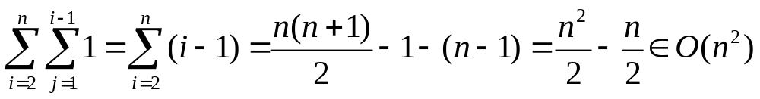
Algorithm Analysis of Insertion Sort …cont’d

Slide 16
Bubble Sort
Pass through the array of elements
Exchange adjacent elements, if necessary
When no exchanges are required, then array is sorted.
Make as many passes as the number of elements of the array

Slide 17
Algorithm of Bubble Sort
void bubbleSort()
{
int i, j;
for (i=n; i>=1; i--)
for (j=2; j<=i; j++)
if (a[j-1] > a[j])
swap(a[j-1],a[j]);
}

Slide 18
Bubble Sort Example
Initial sequence
After third turn of outer for loop
48
16
24
20
8
12
32
54
72
16
8
12
20
24
32
48
54
72
......
inner loop swaps
a[j-1]>a[j]→swap
After first turn of outer for loop
a[j-1]>a[j]→swap
16
24
20
8
12
32
48
54
72
After fourth turn of outer for loop
8
12
16
20
24
32
48
54
72
a[j-1]>a[j]→swap
outer loop swaps
No more swaps necessary!
After second turn of outer for loop
16
20
8
12
24
32
48
54
72
Final sequence
Keys in purple spots are those
that have been swapped to move
towards their correct position.
8
12
16
20
24
32
48
54
72
a[j-1]>a[j]→swap

Slide 19
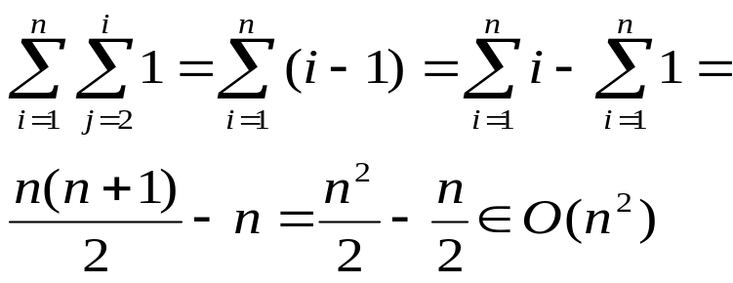
Algorithm Analysis of Bubble Sort
Barometer statement (or piece of code): the condition of if (a[j-1] > a[j])
We find how many times it is executed
The outer loop turns n times.
Inner loop turns i-1 times at the i^{th} turn of the outer loop.

Slide 20
Other (O(n*lg(n))) Sorting Techniques
We discuss three (internal) sorting techniques
  Heapsort
  Mergesort
  Quicksort

Slide 21
Heapsort
Idea: Delete_Min operation in a minimum heap removes the key in root.
The hole at the root percolates down where, in the array we keep the minimum heap, proper keys are moved left accordingly.
The last cell in the array becomes available for storing another key.
If we perform the delete_min operation n times in an n-element min heap and place the i^{th} key removed at the available cell A[n-i], we will obtain a sorted sequence of the keys in the heap in descending order.

Slide 22
Algorithm of Heapsort
int heapsort(Elmnt_Type *A)
{ // sorts keys in minheap A in descending order...
Elmnt_Type x;
for (i=1;i<=n;i++)
{
x=DeleteMin(A); // O(lgn)
A[n-i]=x; // O(1)
}
}

Slide 23
Heapsort Example
Empty
8
15
21
46
37
27
23
92
93
45
116
42
87
34
66
111
98
95
Empty
15
37
21
46
45
27
23
92
93
95
116
42
87
34
66
111
98
8
Empty
21
37
23
46
45
27
34
92
93
95
116
42
87
98
66
111
15
8

Slide 24
Heapsort Example
Empty
21
37
23
46
45
27
34
92
93
95
116
42
87
98
66
111
15
8
Empty
23
37
27
46
45
42
34
92
93
95
116
111
87
98
66
21
15
8
Empty
27
37
34
46
45
42
66
92
93
95
116
111
87
98
23
21
15
8

Slide 25
Heapsort Example
Empty
27
37
34
46
45
42
66
92
93
95
116
111
87
98
23
21
15
8
Empty
34
37
42
46
45
87
66
92
93
95
116
111
98
27
23
21
15
8
Empty
37
45
42
46
95
87
66
92
93
98
116
111
34
27
23
21
15
8
Shifts by are performed to restore the heap order property of the minimum heap.

Slide 26
Heapsort Example
Empty
37
45
42
46
95
87
66
92
93
98
116
111
34
27
23
21
15
8
Empty
42
45
66
46
95
87
111
92
93
98
116
37
34
27
23
21
15
8
Empty
45
46
66
92
95
87
111
116
93
98
42
37
34
27
23
21
15
8
Shifts by are performed to restore the heap order property of the minimum heap.

Slide 27
Heapsort Example
Empty
45
46
66
92
95
87
111
116
93
98
42
37
34
27
23
21
15
8
Empty
46
92
66
93
95
87
111
116
98
45
42
37
34
27
23
21
15
8
Empty
66
92
87
93
95
98
111
116
46
45
42
37
34
27
23
21
15
8
Shifts by are performed to restore the heap order property of the minimum heap.

Slide 28
Heapsort Example
Empty
66
92
87
93
95
98
111
116
46
45
42
37
34
27
23
21
15
8
Empty
87
92
98
93
95
116
111
66
46
45
42
37
34
27
23
21
15
8
Empty
92
93
98
111
95
116
87
66
46
45
42
37
34
27
23
21
15
8
Shifts by are performed to restore the heap order property of the minimum heap.

Slide 29
Heapsort Example
Empty
92
93
98
111
95
116
87
66
46
45
42
37
34
27
23
21
15
8
Empty
93
95
98
111
116
92
87
66
46
45
42
37
34
27
23
21
15
8
Empty
95
111
98
116
93
92
87
66
46
45
42
37
34
27
23
21
15
8
Shifts by are performed to restore the heap order property of the minimum heap.

Slide 30
Heapsort Example
Empty
95
111
98
116
93
92
87
66
46
45
42
37
34
27
23
21
15
8
Empty
98
111
116
95
93
92
87
66
46
45
42
37
34
27
23
21
15
8
Empty
111
116
98
95
93
92
87
66
46
45
42
37
34
27
23
21
15
8
Shifts by are performed to restore the heap order property of the minimum heap.

Slide 31
Heapsort Example
Empty
111
116
98
95
93
92
87
66
46
45
42
37
34
27
23
21
15
8
Empty
116
111
98
95
93
92
87
66
46
45
42
37
34
27
23
21
15
8
Sequence in the array is sorted in descending order!
Empty
116
111
98
95
93
92
87
66
46
45
42
37
34
27
23
21
15
8

Slide 32
Algorithm Analysis of Heap Sort
Every turn of the for loop:
  One delete_min is performed, O(lg n);
  Key in the root is placed in last element of the current queue, O(1).
For loop is executed n times for a heap with n elements
Hence, running time of heap sort is O(n lgn).

Slide 33
Merging two sorted lists
Consider two sorted lists L1, L2 and an empty list R.
The following algorithm merges L1 and L2 in R:
  a and b point to first element of L1 and L2, respectively,
  c points to the empty resulting list;
  while both lists have elements left
    select as the next element of resulting list min(L1[a],L2[b]);
    advance the pointers or indices of the result list and the input list with the smaller element
  Append rest of longer list (among L1 and L2) to R

Slide 34
Merging two sorted lists: Algorithm
struct nodetype {
int k;
struct node * next;
}
typedef struct nodetype nodetype;
typedef nodetype * nodeptrtype;
int N,M; nodeptrtype z;// z is a special header
nodeptrtype merge (nodeptrtype a, nodeptrtype b)
{
nodeptrtype c;
c=z;
do
if (a->k <=b->k) {c->next=a; c=a; a=a->next;}
else {c->next=b; c=b; b=b->next;}
while (c->k < maxint);
merge=z->next; z->next=z;
}
main( );
{
scanf (“%d %d”, &M, &N);
z=malloc(nodetype);
z->k=maxint; z->next=z;
… /* Lists a and b are constructed here */
merge (a,b);
}

Slide 35
Merging two sorted lists: Example
14
31
43
65
L1
15
37
40
42
L2
c
R
z

Slide 36
Merging two sorted lists: Example
L1
14
31
43
65
a
a<b
b
15
37
40
42
L2
c
14
R
z

Slide 37
Merging two sorted lists: Example
L1
14
31
43
65
a
a<b
b
15
37
40
42
L2
c
R
14
15
z

Slide 38
Merging two sorted lists: Example
L1
14
31
43
65
a
a<b
b
15
37
40
42
L2
c
R
14
15
31
z

Slide 39
Merging two sorted lists: Example
L1
14
31
43
65
a
a<b
b
15
37
40
42
L2
c
14
15
31
37
R
z

Slide 40
Merging two sorted lists: Example
L1
14
31
43
65
a
a<b
b
15
37
40
42
L2
c
14
15
31
37
40
R
z

Slide 41
Merging two sorted lists: Example
L1
14
31
43
65
a
a<b
b
15
37
40
42
null
L2
c
14
15
31
37
40
42
R
z

Slide 42
Merging two sorted lists: Example
L1
14
31
43
65
a
a<b
b
15
37
40
42
L2
c
14
15
31
37
40
42
43
65
R
z

Slide 43
Mergesort: Idea
This is a divide & conquer algorithm.
Given the merge algorithm, we may sort a sequence of n keys by
  dividing the sequence into (divide section)
    2 subsequences each of n/2 elements,
    4 subsequences each of n/4 elements,
    8 subsequences each of n/8 elements,
    ...
    n subsequences each of 1 element,
  recursively sort (using mergesort) each consecutive pair of sequences, (conquer section)
  merge the two sorted subsequences to obtain the sorted sequence (combine section)

Slide 44
Mergesort: Algorithm
nodeptrtype sort (nodeptrtype c; int N)
{
nodeptrtype a,b; int i;
if (c->next == z) return c;
else {
a=c;
for (i=1;i<N/2;i++;c=c->next);
b=c->next; c->next=z;
return merge(sort(a,N/2), sort(b,N-(N/2))
}
}

Slide 45
Mergesort: Example
37
40
43
65
15
14
42
z
sort
a
z
37
40
43
65
15
14
42
z
b

Slide 46
Mergesort: Example
a
37
40
43
z
a
sort
b
37
40
43
z
z

Slide 47
Mergesort: Example
b
40
43
z
a
sort
b
40
43
z
z
merge
a
40
43
z

Slide 48
Mergesort: Example
a
b
37
40
43
z
z
merge
a
37
40
43
z

Slide 49
Mergesort: Example
z
65
15
14
42
b
sort
z
z
65
15
14
42
a
b

Slide 50
Mergesort: Example
z
z
65
15
14
42
a
b
sort
sort
z
z
z
z
65
15
14
42
a
b
a
b

Slide 51
Mergesort: Example
z
z
z
z
65
15
14
42
a
b
a
b
merge
merge
z
z
15
65
14
42
a
b

Slide 52
Mergesort: Example
z
z
15
65
14
42
a
b
merge
z
14
15
42
65
a

Slide 53
Mergesort: Example
a
z
37
40
43
14
15
42
65
z
b
merge
a
14
15
37
40
42
43
65
z

Slide 54
Algorithm Analysis of Mergesort
The maximum number of comparisons per merging of two sequences for a total of n elements is
n-1= Θ(n).
How many partitions of how many elements are merged?
  Merging once n/2 keys with n/2 keys = n/2+n/2-1
  Merging twice n/4 keys with n/4 keys = 2(n/4+n/4-1)
  Merging 4 times n/8 keys with n/8 keys = 4(n/8+n/8-1)
  ...
  Merging n/2 times one key with another key = n/2.

Slide 55
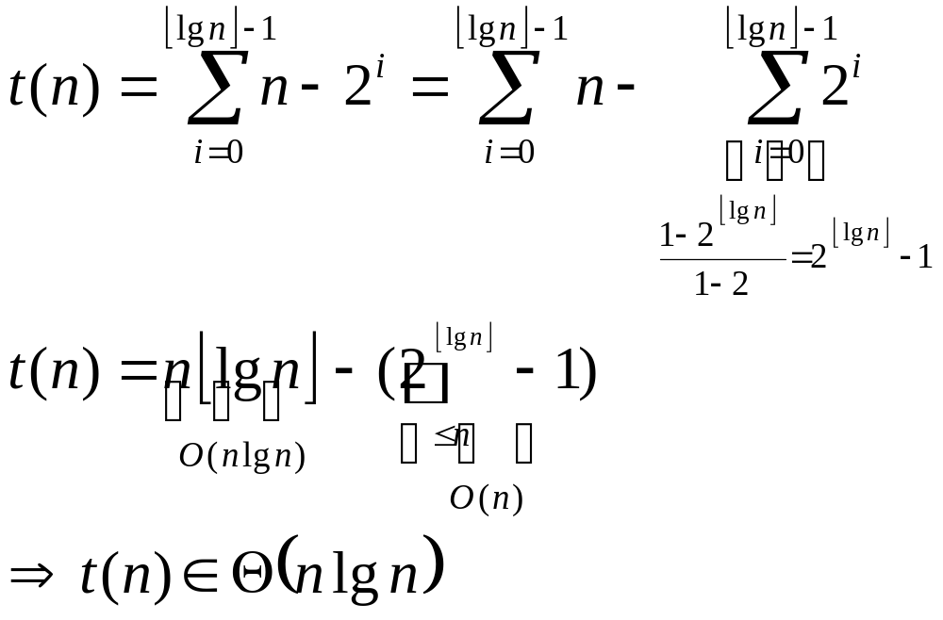
Algorithm Analysis of Mergesort
Hence, running time of mergesort is Θ(n lgn).

Slide 56
Quicksort: Idea
Another popular divide & conquer sort algorithm.
The idea here is that, at every call of a specific partitioning algorithm, a selected key (pivot) is placed at its correct position, and all keys less are moved to left while those greater than that key are carried over to the right of the key.
The original partitioning algorithm used in quicksort is devised by C.A.R. Hoare.

Slide 57
Quicksort: Idea
After partitioning, the original sequence is divided into three subsequences:
  Numbers to the left of pivot (still needs sorting)
  Pivot (correctly placed)
  Numbers to the right of pivot (still needs sorting)
Recursively calling quicksort function for the left and right subsequences, we sort the entire array.

Slide 58
Quicksort: Algorithm
Quicksort(A,l,r)
{ //A is the array holding the key sequence
// l,r are the lowest and highest index values of // the key sequence in respective order.
// m is the index value of the pivot.
if (l<r)
m=partition(A,l,r);
Quicksort(A,l,m-1);
Quicksort(A,m+1,r);
}

Slide 59
Quicksort: Conceptual Example
pivot
61
78
51
6
34
23
82
47
11
69
95
56
28
11
23
78
34
28
95
47
56
69
51
6
61
82

Slide 60
Quicksort: Conceptual Example
pivot
11
23
34
28
47
6
51
34
78
6
23
47
28
56
95
11
69
51
61
82

Slide 61
Quicksort: Conceptual Example
pivot
6
11
Empty!
pivot
6
11
23
34
78
6
11
23
47
28
95
56
69
51
61
82

Slide 62
Quicksort: Conceptual Example
pivot
34
78
6
11
23
47
28
95
56
69
51
61
82
78
6
11
23
34
28
47
51
56
95
69
61
82

Slide 63
Quicksort: Conceptual Example
pivot
78
6
11
23
34
47
51
56
95
28
69
61
82
pivot
78
6
11
23
28
34
47
51
56
95
69
61
82
78
28
34
47
51
56
95
6
11
23
69
61
82

Slide 64
Quicksort: Conceptual Example
pivot
78
6
11
23
28
34
47
51
56
95
69
61
82
78
95
6
11
23
28
34
47
51
56
69
61
82
The right subsequence of the original sequence is sorted similarly.

Slide 65
Partitioning*: Idea
The idea here is to group keys so that
  all keys less than pivot are at left of pivot, and
  all greater keys are at the right of pivot,
The pivot is the last key of the sequence.
At any time, the rest of the sequence consists of three subsequences:
  the left subsequence holds keys less than the pivot;
  the middle subsequence holds keys greater than the pivot;
  the right subsequence holds keys not yet sorted;
Initially, the left and middle subsequences are empty. Any time a key in the right subsequence is processed (i.e., compared with pivot), it is purged from the right and placed to the left or middle sequence.
*main reference for this algorithm is [1]

Slide 66
Partitioning: Algorithm
Partition(A,l,r)
{
x=A[r];
i=l-1;
for (j=l;j<r; j++) {
if (A[j]<=x) {i++; swap(A[i],A[j])}
}
swap(A[i+1],A[r]);
return i+1;
}
*main reference for this algorithm is [1]

Slide 67
Partitioning: Example
i
l
j
r
Initial Sequence
62
8
15
92
46
37
27
23
21
93
45
116
42
87
34
95
111
98
66
l
i
j
r
After 1st turn of for loop
62
8
15
92
46
37
27
23
21
93
45
116
42
87
34
95
111
98
66
l
i
j
r
After 2nd turn of for loop
62
8
15
92
46
37
27
23
21
93
45
116
42
87
34
95
111
98
66

Slide 68
Partitioning: Example
l
i
j
r
After 3rd turn of for loop
62
8
15
92
46
37
27
23
21
93
45
116
42
87
34
95
111
98
66
l
i
j
r
After 4th turn of for loop
62
8
15
92
46
37
27
23
21
93
45
116
42
87
34
95
111
98
66
After 5th turn of for loop
l
i
j
r
62
8
15
46
92
37
27
23
21
93
45
116
42
87
34
95
111
98
66

Slide 69
Partitioning: Example
After 6th turn of for loop
l
i
j
r
62
8
15
46
37
92
27
23
21
93
45
116
42
87
34
95
111
98
66
After 7th turn of for loop
l
i
j
r
62
8
15
46
37
27
92
23
21
93
45
116
42
87
34
95
111
98
66
After 8th turn of for loop
l
i
j
r
62
8
15
46
37
27
23
92
21
93
45
116
42
87
34
95
111
98
66

Slide 70
Partitioning: Example
After 9th turn of for loop
l
i
j
r
62
8
15
46
37
27
23
21
92
93
45
116
42
87
34
95
111
98
66
After 10th turn of for loop
l
i
j
r
62
8
15
46
37
27
23
21
92
93
45
116
42
87
34
95
111
98
66
After 11th turn of for loop
l
i
j
r
62
8
15
46
37
27
23
21
45
93
92
116
42
87
34
95
111
98
66

Slide 71
Partitioning: Example
After 12th turn of for loop
l
i
j
r
62
8
15
46
37
27
23
21
45
93
92
116
42
87
34
95
111
98
66
After 13th turn of for loop
l
i
j
r
62
8
15
46
37
27
23
21
45
42
92
116
93
87
34
95
111
98
66
After 14th turn of for loop
l
i
j
r
62
8
15
46
37
27
23
21
45
42
92
116
93
87
34
95
111
98
66

Slide 72
Partitioning: Example
After 15th turn of for loop
l
i
j
r
62
8
15
46
37
27
23
21
45
42
34
116
93
87
92
95
111
98
66
l
After 16th turn of for loop
i
j
r
62
8
15
46
37
27
23
21
45
42
34
116
93
87
92
95
111
98
66
After 17th and 18th turn of for loop
l
i
j
r
62
8
15
46
37
27
23
21
45
42
34
116
93
87
92
95
111
98
66

Slide 73
Partitioning: Example
After execution of return statement
l
i
j
r
62
8
15
46
37
27
23
21
45
42
34
66
93
87
92
95
111
98
116

Slide 74
Hoare’s Partitioning: Idea
The idea is to simply check the sequence starting at both ends to see that
  no keys less than pivot should remain to right of pivot, and
  no greater keys to left,
If any two such keys exist, they are swapped to have them at their correct sides.

Slide 75
Hoare’s Partitioning: Idea
To accomplish this, two pointers (e.g., i and j) start at both ends of the sequence to scan through moving towards each other.
Whenever a pointer locates a key in an incorrect position (i.e., a greater key to left of pivot or a key less than the pivot at its right), it stops moving. When both pointers stop, the keys they point to are swapped and they restart moving.
Scanning terminates when pointers pass crossing each other, and the key is placed at the position pointed to by j.

Slide 76
Hoare’s Partitioning: Algorithm
Partition_Hoare(A,l,r)
{
x=A[l];
i=l-1; j=r+1;
while true
do j-=1 while A[j]>x;
do i+=1 while A[i]<x;
if (i<j) swap A[i]↔A[j];
else {
swap(A[j],A[l])
return j;
}
}

Slide 77
Hoare’s Partitioning: Example
i
l
r
j
Initial Sequence
62
8
15
92
46
37
27
23
21
93
45
116
42
87
34
95
111
98
66
l
i
After 1st turn of while loop
j
r
62
8
15
34
46
37
27
23
21
93
45
116
42
87
92
95
111
98
66
After 2nd turn of while loop
l
j
i
r
62
8
15
34
46
37
27
23
21
42
45
116
93
87
92
95
111
98
66
i>j, not exchanged

Slide 78
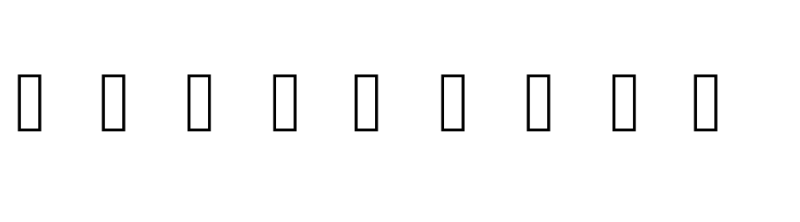
Hoare’s Partitioning: Example
l
At the end of partitioning
j
i
r
45
8
15
34
46
37
27
23
21
42
62
116
93
87
92
95
111
98
66
keys < pivot
keys > pivot
Pivot correctly placed

Slide 79
Algorithm Analysis for Quicksort
Average case:
Each pivot at position m has a left and a right subsequence with m-1 and n-m keys, respectively, to sort. Hence, the running time f(n) of quicksort for n elements can be expressed as follows
f(n)=f(m-1)+f(n-m)+Θ(n).
The term “Θ(n)” is the time that partitioning takes to place the key selected as pivot at its correct position m.

Slide 80

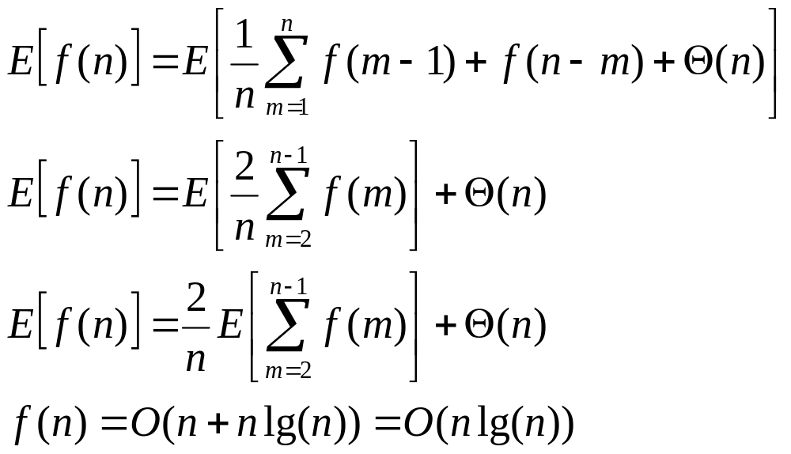
Algorithm Analysis for Quicksort
m and n-m can be any number between between 1 and n.
To come up with a general solution, we can average f(m-1) and f(n-m):

Slide 81
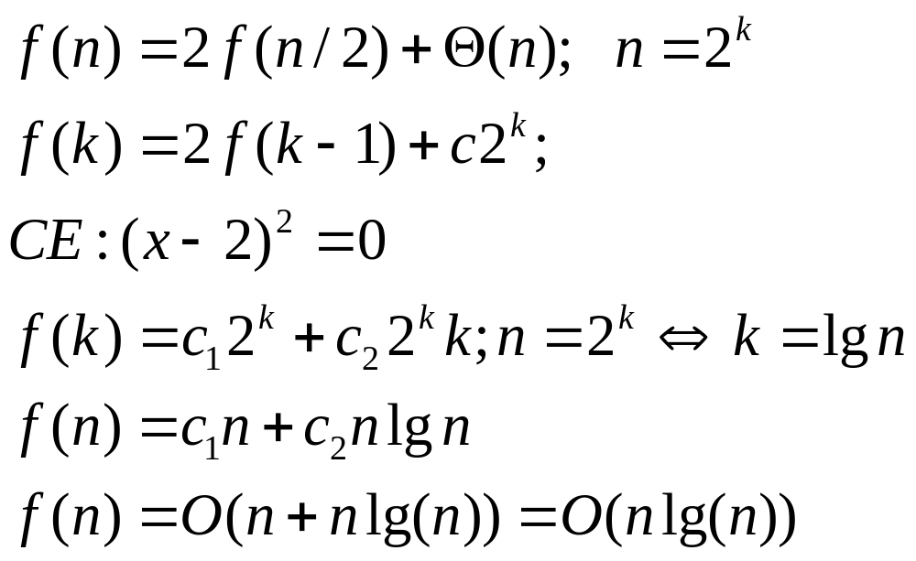
Algorithm Analysis for Quicksort
Best Case: The pivot is placed always in the middle.
f(n)=2f(n/2)+Θ(n);

Slide 82
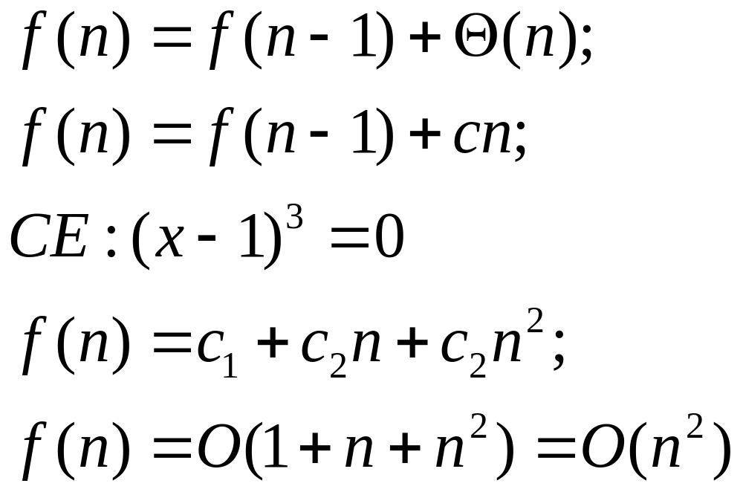
Algorithm Analysis for Quicksort
Worst Case: The sequence is sorted in the opposite order..
f(n)=f(n-1)+Θ(n);

Slide 83
Selecting the pivot...
Pivot selection method may essentially affect quicksort performance.
Selecting the first (or the last) would work alright if the sequence is purely randomly built. If not, the worst case is not totally unlikely to occur.
Selecting the pivot randomly works well. However, the random number generator should generate numbers sufficiently randomly. Furthermore, random number generation is an expensive process.
Median-of-3 partitioning (median of a sequence is the ⎡n/2⎤ highest among n keys in a sequence) is to select as the pivot the second largest among the leftmost, rightmost and middle keys in the sequence.

Slide 84
A O(n)-Expected-Time Selection Algorithm
Quicksort can be modified to select the k^{th} largest
key in the sequence.
Select a pivot
Have it placed at its correct position m
If (k<m) recursively call quicksort for the left subsequence only
Else recursively call quicksort for the right subsequence only.

Slide 85
Conceptual Example: O(n)-Expected-Time Selection
Pivot
Problem: Find third smallest key (i.e., key at cell 2)!
Initial Sequence
62
8
15
92
46
37
27
23
21
93
45
116
42
87
34
95
111
98
66
62 placed at array cell 10… Since 2 < 10,
we consider only numbers less than 62
45
8
15
34
46
37
27
23
21
42
62
45 placed at array cell 8… Since 2 < 8,
we consider only numbers less than 45
21
8
15
34
42
37
27
23
45
21 placed at array cell 2… Since 2=2 ,
we stop. Third smallest key is 21.
15
8
21
34
42
37
27
23

Slide 86
Reference...
[1] T.H. Cormen, C.E. Leiserson, R.L. Rivest, C. Stein,
“Introduction to Algorithms,” 2nd edition, MIT Press,
2003
[2] M.A. Weiss, “Data Structures and Algorithm
Analysis in C,” 2nd edition, Addison-Wesley, 1997

